Slide 1
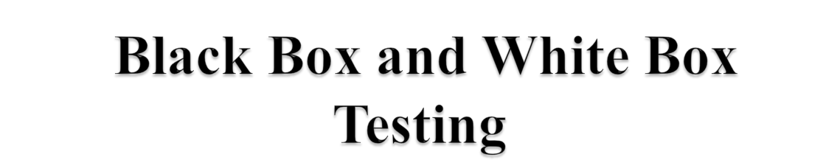

Learning Objectives :
The Test Method
Black Box Testing
Equivalence partitioning
Boundary Value Analysis
Use case based testing
State Transition Testing
White Box - testing
techniques
Cyclomatic Complexity

Slide 2
Test Methods
Black Box Testing
Black box testing is testing that ignores the internal mechanism of a system or component and focuses solely on the outputs generated in response to selected inputs and execution conditions.
(also called as Behavioral testing, Functional testing, Data driven testing, I/O driven testing)
White Box Testing
White box testing is testing that takes into account the internal mechanism of a system or component.
Also called as Structural testing, Glass box testing, Transparent-box and Clear box Testing

Slide 3
Black Box Testing
Approach to the testing where program is considered as a “black box”.
The system is considered as a black box where the outputs of the test results are matched against user Specifications.
Inputs are given and outputs are compared against specifications.
No implementation details of the code are considered.
Test cases are based on requirement specifications.

Slide 4
Black Box Testing
Test Case Design methods:
  Equivalence Class partitioning method
  Boundary value analysis
  Decision Tables
  State transition testing
  Use case based testing
  Error guessing

Slide 5
Equivalence partitioning
  Equivalence partitioning is a black-box testing method
  Divide the input domain of a program into classes of data
  Derive test cases based on these partitions.
  An equivalence class represents a set of valid or invalid states for input condition.

Slide 6
Boundary Value Analysis
Many systems have tendency to fail on boundary. So testing boundary values of application is important.
Boundary Value Analysis (BVA) is a test Functional Testing technique where the extreme boundary values are chosen.
Boundary values include maximum, minimum, just inside/outside boundaries, typical values, and error values.
Extends equivalence partitioning, Test both sides of each boundary
Look at output boundaries for test cases too
Min – 1, Min, Min +1, Nom, Max -1, Max, Max +1

Slide 7
Example: Loan
Application
Customer Name
Account number
Loan amount requested
2-64 chars.
6 digits, 1st
non-zero
£500 to £9000

Slide 8
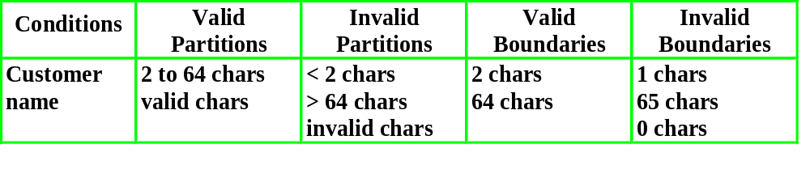
Customer name
Number of characters:
1
2
64
65
invalid
valid
invalid
Valid characters:
A-Z
a-z
Any
other
-’
space

Slide 9
Account number
valid: non-zero
first character:
invalid: zero
number of digits:
5
6
7
invalid
invalid
valid

Slide 10
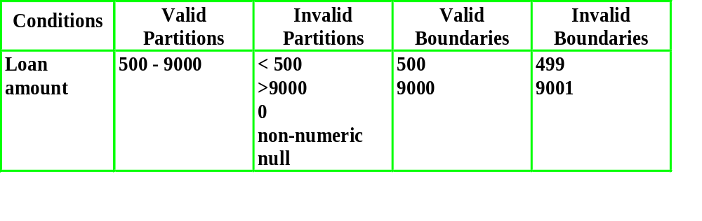
Loan amount
499
500
9000
9001
invalid
valid
invalid

Slide 11
Decision Tables
Explore combinations of inputs, situations or events
It is very easy to overlook specific combinations of input
Start by expressing the input conditions of interest so that they are either TRUE or FALSE

Slide 12
Example: Login Page
User Name
Password
Submit
Reset

Slide 13
Decision Table
Input Conditions | 1 | 2 | 3 | 4
User Name | True | True | False | False
Password | True | False | True | False
Output Conditions | Login Successful | Login Unsuccessful | Login Unsuccessful | Login Unsuccessful

Slide 14
State Transition Testing
Process of writing the test cases for each and every possible look where application or system is changing the state from one state to another state.

Slide 15
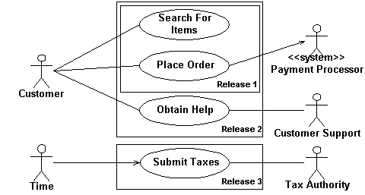
Use case based testing
Actors represented with help of stick diagram and use cases are represented with help of ellipse.

Slide 16
Use Case Test Case
U.C Name | Login
U.C Description | Login can authorize users
Actors | Users of the application
Related U.C | User Registration
Preconditions | Users must have registered and be given a valid login
Primary Scenario | 1.View home page 2.Enter user id and password 3.Validate user login 3.1 [if valid] Allow further access 3.2 [if invalid] Deny access
Alternative Scenario | None
Post Conditions | Application allows valid users further transaction
UI Mock Up | A model user screen
Special Requirements | None

Slide 17
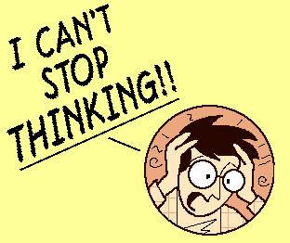
Error Guessing
Tester guesses from his /her experience on the error-prone area and concentrates around that area.
Example : When the bike stops, first thing you do is – check the petrol.
You probably wont
go to mechanic or
read the manual or
check the spark plug
You know from your experience or
usage that petrol could be over.

Slide 18
Advantages of Black box testing
More effective on larger units of code than glass box testing.
Testers and developers are independent of each other.
Tester needs no knowledge of code in which system is designed.
Testing is done from a user’s point of view.
Test cases can be designed as soon as specifications are complete.

Slide 19
Disadvantages of Black Box testing
Only a small number of possible inputs can actually be tested
Without clear and concise specifications, test cases are hard to design.
Repetition of test inputs if tester is not informed of the test cases the programmer has already tried.
May leave many program paths untested

Slide 20
White box Testing
Contrary to black box testing
Testing based on analysis of internal logic (design, code, etc.).
White-box testing techniques apply primarily to lower levels of testing (e.g., unit and component).
Targets to check control flow, looping, dataflow, all the nodes and paths.
Mandatory to have a knowledge of code in which the system is designed.

Slide 21

Statement coverage
Decision coverage
Condition Coverage

Slide 22
Statement coverage
Execute all the statements at least once
Weakest form of coverage as it requires every line of code to be checked
?

Slide 23
Decision coverage
(Branch coverage)
Exercise all logical decision on
their true or false sides.
To test the branch we must once
check the true condition and once
the false condition
False
?
True

Slide 24
Condition Coverage
Execute each decision with all possible outcomes at least once
It requires all cases.
Checks each of the ways condition can be made true or false

Slide 25
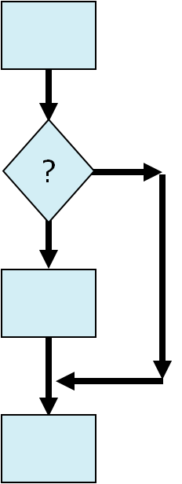
Condition Coverage
1
2
3
4
?
2
2
3
1
1
?
?
?

Slide 26
Cyclomatic Complexity
It is important to testers because it provides an indication of the amount of testing.
Cyclomatic complexity is defined as
control flow graph G,
cyclomatic complexity V(G):
V(G)= E-N+2 Where
    N is the number of nodes in G
    E is the number of edges in G

Slide 27
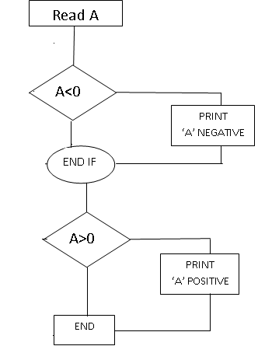
Cyclomatic Complexity
Read A
IF A < 0 THEN
Print “A negative”
ENDIF
IF A > 0 THEN
Print “A positive”
ENDIF
Cyclomatic complexity= 3
E-N+2
8-7+2=3

Slide 28
Advantage of WBT
As the knowledge of internal coding structure is pre-requisite, it becomes very easy to find out which type of input/data can help in testing the application effectively.
It helps in optimizing the code.
Helps in removing the extra lines of code, which can bring in hidden defects.

Slide 29
Disadvantages of WBT
As the knowledge of internal coding structure is pre-requisite, a skilled tester is needed. So cost increases.
It is impossible to look into every bit of code to find out hidden errors, which may create problems, resulting in failure of an application.
It fails to detect missing functions.

Slide 30
Question
What is Black box and White box testing?
Advantages & Disadvantages of Black Box testing
Advantages & Disadvantages of White Box testing
Explain different methods of black box testing?
Explain different coverages of White box testing?
What is cyclomatic complexity ?
Explain EP and BVA with example ?

Slide 31



